Slide 1



Noida Institute of Engineering and Technology, Greater Noida
Introduction
Unit: 1
DBMS
Ms. Roshan Jameel
Assistant Professor
(AI, SoCSET)
Course Details (B Tech IVth Sem)

Slide 2


Brief Introduction of Faculty member
Name: Roshan Jameel
Qualification: M.Tech (CSE), Pursuing PhD (CSE)
Area of Research: Cloud Computing, Blockchain, Data Security, Artificial Intelligence
Contact Details:
Email: roshan.jameel@niet.co.in
Phone/Whatsapp: +91 9717168058

Slide 3
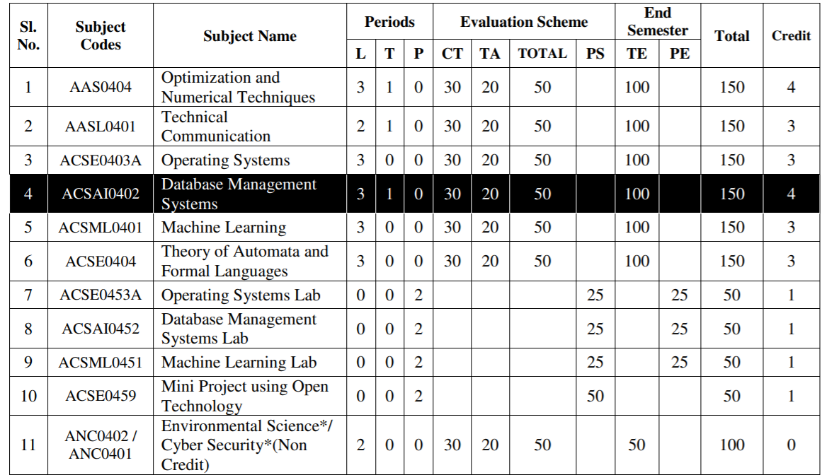
Evaluation Scheme

Slide 4
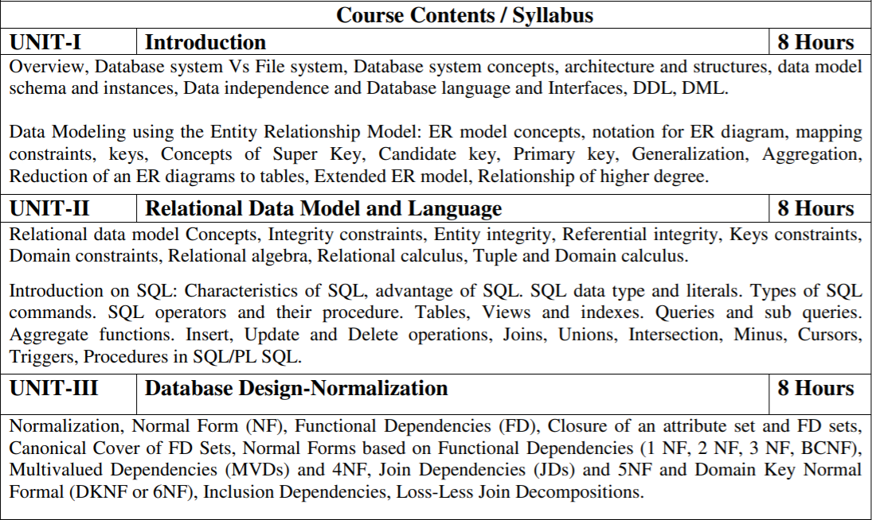
Subject Syllabus

Slide 5
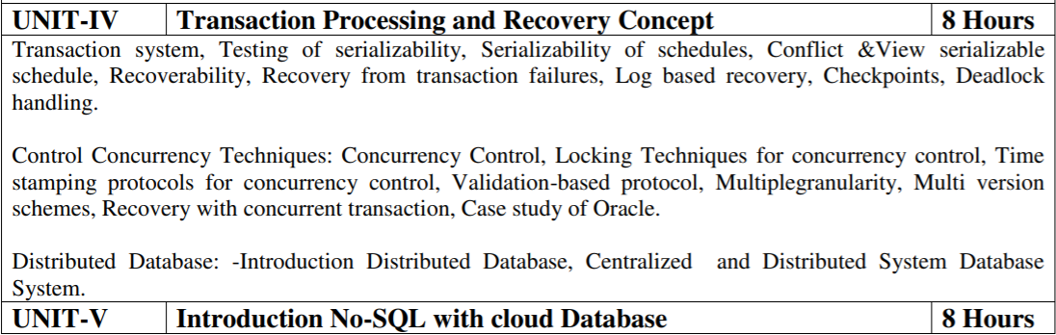
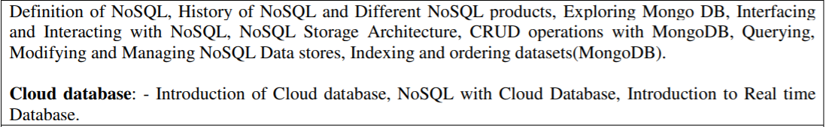
Subject Syllabus

Slide 6
Branch wise Applications
1. AI - Apache Cassandra is an open-source and highly scalable NoSQL database management system that is designed to manage massive amounts of data in a faster manner. This popular database is being used by GitHub, Netflix, Instagram, Reddit, among others.
2. IoT - IoT devices' primary purpose is often to collect and/or generate data and share it for some higher purpose such as analytics, machine learning and artificial intelligence. Consequently, IoT DBMSs need to manage not just data at rest, but also data in transit.
3. CS – There are various application of dbms in different fields like Railway Reservation System, Library Management System, Banking, Universities and colleges, Credit card transactions etc

Slide 7
Course Objective
The objective of course is to present an introduction to database management systems, with an emphasis on how to organize, maintain and retrieve-efficiently, and effectively –information in relational and non-relational Database.
List and explain the fundamental concepts of a relational database system
Knowledge of DBMS, both in terms of use and implementation/design.
Experience with SQL and Manipulate a database using SQL
Increased proficiency with the programming language C++.
Experience working as part of team v Experience with analysis and design of (DB) software
Assess the quality and ease of use of data modeling and diagramming tools.

Slide 8
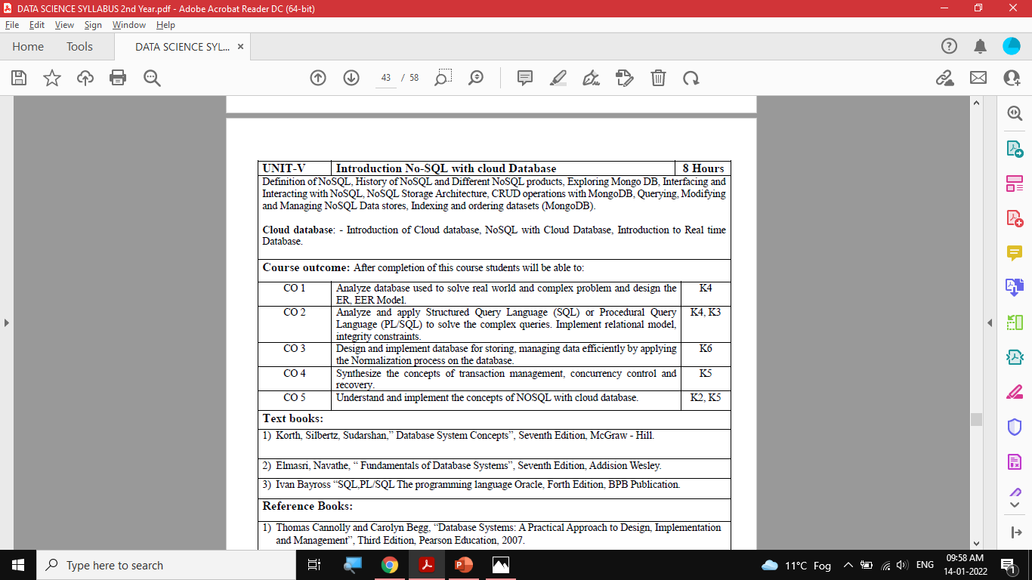
Course Outcomes (COs)

Slide 9

Program Outcomes (POs)
Engineering Graduates will be able to:
1. Engineering knowledge: Apply the knowledge of mathematics, science, engineering fundamentals, and an engineering specialization to the solution of complex engineering problems.
2. Problem analysis: Identify, formulate, review research literature, and analyze complex engineering problems reaching substantiated conclusions using first principles of mathematics, natural sciences, and engineering sciences.
3. Design/development of solutions: Design solutions for complex engineering problems and design system components or processes that meet the specified needs with appropriate consideration for the public health and safety, and the cultural, societal, and environmental considerations.
4. Conduct investigations of complex problems: Use research-based knowledge and research methods including design of experiments, analysis and interpretation of data, and synthesis of the information to provide valid conclusions.

Slide 10
Program Outcomes (POs)
Contd..
5. Modern tool usage: Create, select, and apply appropriate techniques, resources, and modern engineering and IT tools including prediction and modeling to complex engineering activities with an understanding of the limitations.
6. The engineer and society: Apply reasoning informed by the contextual knowledge to assess societal, health, safety, legal and cultural issues and the consequent responsibilities relevant to the professional engineering practice.
7. Environment and sustainability: Understand the impact of the professional engineering solutions in societal and environmental contexts, and demonstrate the knowledge of, and need for sustainable development.
8. Ethics: Apply ethical principles and commit to professional ethics and responsibilities and norms of the engineering practice.

Slide 11
Program Outcomes (POs)
Contd..
9. Individual and team work: Function effectively as an individual, and as a member or leader in diverse teams, and in multidisciplinary settings.
10. Communication: Communicate effectively on complex engineering activities with the engineering community and with society at large, such as, being able to comprehend and write effective reports and design documentation, make effective presentations, and give and receive clear instructions.
11. Project management and finance: Demonstrate knowledge and understanding of the engineering and management principles and apply these to one’s own work, as a member and leader in a team, to manage projects and in multidisciplinary environments.
12. Life-long learning: Recognize the need for, and have the preparation and ability to engage in independent and life-long learning in the broadest context of technological change.

Slide 12
COs and POs Mapping
 | PO1 | PO2 | PO3 | PO4 | PO5 | PO6 | PO7 | PO8 | PO9 | PO10 | PO11 | PO12
KCS501.1 | 2 | 2 | 3 | 3 | 3 | 2 | 3 | 2 | 2 | 2 | 2 | 3
KCS501.2 | 3 | 3 | 3 | 2 | 2 | 2 | 2 | 2 | 2 | 2 | 2 | 3
KCS501.3 | 2 | 3 | 3 | 3 | 3 | 2 | 2 | 2 | 2 | 2 | 2 | 2
KCS501.4 | 2 | 3 | 2 | 2 | 2 | 2 | 2 | 2 | 2 | 3 | 2 | 2
KCS501.5 | 2 | 3 | 2 | 2 | 2 | 3 | 2 | 2 | 3 | 2 | 2 | 2
AVG | 2.20 | 2.80 | 2.60 | 2.40 | 2.40 | 2.20 | 2.20 | 2.00 | 2.20 | 2.20 | 2.00 | 2.40

Slide 13
Program Specific Outcomes (PSOs)

Slide 14
COs and PSOs Mapping
 | Program Specific Outcomes
 | PSO1 | PSO2 | PSO3 | PSO4
KCS-501.1 | 3 | 1 | 3 | 1
KCS-501.2 | 3 | 1 | 3 | 1
KCS-501.3 | 3 | 1 | 3 | 1
KCS-501.4 | 3 | 1 | 3 | 1
KCS-501.5 | 3 | 1 | 3 | 1
AVG | 3.00 | 1.00 | 3.00 | 1.00

Slide 15
Program Educational Objectives (PEOs)

Slide 16
Result Analysis

Slide 17
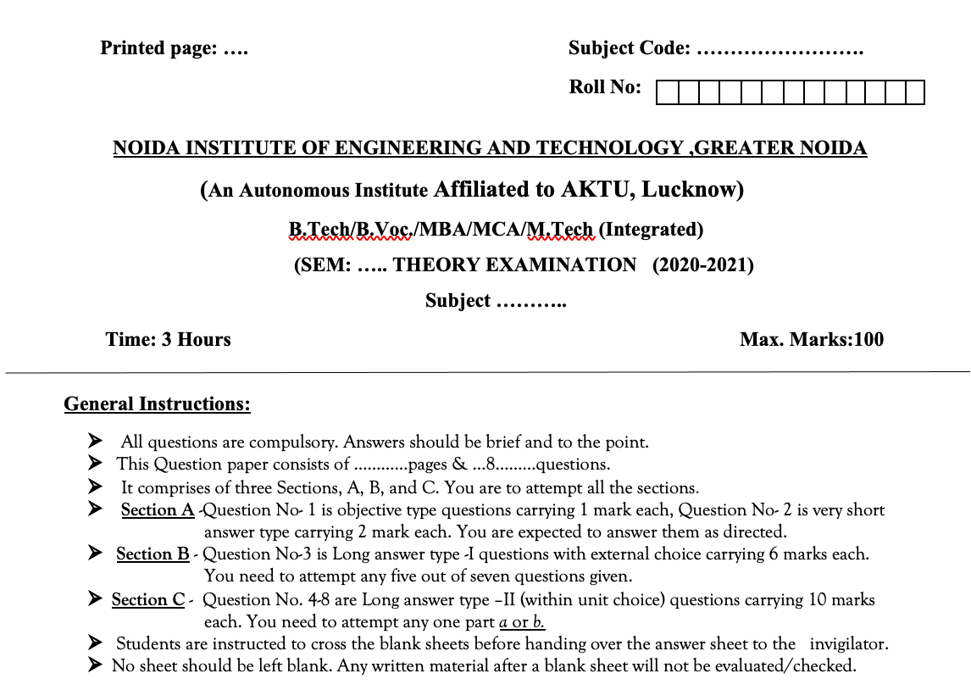

Question Paper Template

Slide 18
Question Paper Template
 |  | SECTION – A |  | CO
 | Attempt all parts- |  | [10×1=10]
 | 1-a. | Question- | (1)
 | 1-b. | Question- | (1)
 | 1-c. | Question- | (1)
 | 1-d. | Question- | (1)
 | 1-e. | Question- | (1)
 | 1-f. | Question- | (1)
 | 1-g. | Question- | (1)
 | 1-h. | Question- | (1)
 | 1-i. | Question- | (1)
 | 1-j. | Question- | (1)
2. | Attempt all parts- |  | [5×2=10] | CO
 | 2-a. | Question- | (2)
 | 2-b. | Question- | (2)
 | 2-c. | Question- | (2)
 | 2-d. | Question- | (2)
 | 2-e. | Question- | (2)
SECTION – B |  |  |  | CO
3. | Answer any five of the following- |  | [5×6=30]
 | 3-a. | Question- | (6)
 | 3-b. | Question- | (6)
 | 3-c. | Question- | (6)
 | 3-d. | Question- | (6)
 | 3-e. | Question- | (6)
 | 3-f. | Question- | (6)
 | 3-g. | Question- | (6)
SECTION – C |  |  |  | CO
4 | Answer any one of the following- |  | [5×10=50]
 | 4-a. | Question- | (10)
 | 4-b. | Question- | (10)
5. | Answer any one of the following-
 | 5-a. | Question- | (10)
 | 5-b. | Question- | (10)
6. | Answer any one of the following-
 | 6-a. | Question- | (10)
 | 6-b. | Question- | (10)
7. | Answer any one of the following-
 | 7-a. | Question- | (10)
 | 7-b. | Question- | (10)
8. | Answer any one of the following-
 | 8-a. | Question- | (10)
 | 8-b. | Question- | (10)

Slide 19
Prerequisite and Recap
There is No prerequisite for learning DBMS from scratch although having basic knowledge of discrete mathematics and data structure is added advantage.
Having knowledge of basic mathematics like - SUM, DIFFERENCE, AVERAGE, MEAN, MEDIAN, MODE, etc will definitely be a plus point.
Having knowledge on Set Theory will help.
The proper understanding of data structures (B and B+ trees) will help you to understand the DBMS quickly.

Slide 20
Brief Introduction about the Subject
A database management system (DBMS) refers to the technology for creating and managing databases. DBMS is a software tool to organize (create, retrieve, update, and manage) data in a database.
The main aim of a DBMS is to supply a way to store up and retrieve database information that is both convenient and efficient. By data, we mean known facts that can be recorded and that have embedded meaning.
Usually, people use software such as DBASE IV or V, Microsoft ACCESS, or EXCEL to store data in the form of a database. A datum is a unit of data. Meaningful data combined to form information. Hence, information is interpreted data - data provided with semantics. MS. ACCESS is one of the most common examples of database management software.

Slide 21
Content – Unit 1
Introduction: An overview of database management system, database system Vs file system, Database system concept and architecture, data model schema and instances, data independence and database language and interfaces, data definitions language, DML.
Data Modeling using the Entity Relationship Model: ER model concepts, notation for ER diagram, mapping constraints, keys, Concepts of Super Key, candidate key, primary key, Generalization, aggregation, reduction of an ER diagrams to tables, extended ER model, relationship of higher degree.

Slide 22
Unit Objective
The main objectives of database management system are data availability, data integrity, data security, and data independence.
DDL stands for Data Definition Language. DML stands for Data Manipulation Language. DDL statements are used to create database, schema, constraints, users, tables etc. DML statement is used to insert, update or delete the records.
ER diagrams are used to analyze existing databases to find and resolve problems in logic or deployment. Drawing the diagram should reveal where it's going wrong. Business information systems: The diagrams are used to design or analyze relational databases used in business processes.

Slide 23
What is a DBMS? (CO1)
A very large, integrated collection of related data.
Models real-world enterprise.
Entities (e.g., students, courses)
Relationships (e.g., Madonna is taking CS564)
A Database Management System (DBMS) is a software package designed to define, construct and manipulate database.
Database + Database Management System= Database System.

Slide 24
Why Use a DBMS?
Data independence and efficient access.
Reduced application development time.
Data integrity and security.
Uniform data administration.
Concurrent access, recovery from crashes.

Slide 25
Why Study Databases?
Shift from computation to information
at the “low end”: scramble to webspace (a mess!)
at the “high end”: scientific applications
Datasets increasing in diversity and volume.
Digital libraries, interactive video, Human Genome project, EOS project
... need for DBMS exploding
DBMS encompasses most of CS
OS, languages, theory, AI, multimedia, logic

Slide 26
Files vs. DBMS
Application must stage large datasets between main memory and secondary storage (e.g., buffering, page-oriented access, 32-bit addressing, etc.)
Special code for different queries
Must protect data from inconsistency due to multiple concurrent users
Crash recovery
Security and access control

Slide 27
Purpose of Database Systems
In the early days, database applications were built directly on top of file systems
Drawbacks of using file systems to store data:
Data redundancy and inconsistency
Multiple file formats, duplication of information in different files
Difficulty in accessing data
Need to write a new program to carry out each new task
Data isolation — multiple files and formats
Integrity problems
Integrity constraints (e.g. account balance > 0) become “buried” in program code rather than being stated explicitly
Hard to add new constraints or change existing ones

Slide 28
Purpose of Database Systems (Cont.)
Drawbacks of using file systems (cont.)
Atomicity of updates
Failures may leave database in an inconsistent state with partial updates carried out
Example: Transfer of funds from one account to another should either complete or not happen at all
Concurrent access by multiple users
Concurrent access needed for performance
Uncontrolled concurrent accesses can lead to inconsistencies
Example: Two people reading a balance and updating it at the same time
Security problems
Hard to provide user access to some, but not all, data
Database systems offer solutions to all the above problems

Slide 29
Summary
DBMS used to maintain, query large datasets.
Benefits include recovery from system crashes, concurrent access, quick application development, data integrity and security.
Levels of abstraction give data independence.
A DBMS typically has a layered architecture.
DBAs hold responsible jobs and are well-paid! ☺
DBMS R&D is one of the broadest, most exciting areas in CS.

Slide 30
Short Quiz
What is the full form of DBMS? a) Data of Binary Management System b) Database Management System c) Database Management Service d) Data Backup Management System
What is a database? a) Organized collection of information that cannot be accessed, updated, and managed b) Collection of data or information without organizing c) Organized collection of data or information that can be accessed, updated, and managed d) Organized collection of data that cannot be updated

Slide 31
Topic – Data models Objective
Data Model gives us an idea that how the final system will look like after its complete implementation.
It defines the data elements and the relationships between the data elements.
Data Models are used to show how data is stored, connected, accessed and updated in the database management system.

Slide 32
Data Models
A data model is a collection of concepts for describing data.
Categories of Data Models :-
High level or Conceptual Data Model
Concept of entities, attributes and relationships
Low level or physical Data Model
Details of how data is stored in computer
Representational Data Model
Traditional commercial DBMS so called legacy data models- network or hierarchical models.

Slide 33
Data Models
A collection of tools for describing
Data
Data relationships
Data semantics
Data constraints
Relational model
Entity-Relationship data model (mainly for database design)
Object-based data models (Object-oriented and Object-relational)
Semi structured data model (XML)
Other older models:
Network model
Hierarchical model

Slide 34
Schemas and Instances
Similar to types and variables in programming languages
Schema – the logical structure of the database
Example: The database consists of information about a set of customers and accounts and the relationship between them
Analogous to type information of a variable in a program
Instance – the actual content of the database at a particular point in time
Analogous to the value of a variable

Slide 35
Levels of Abstraction
Physical Schema/Level: describes how a record (e.g., customer) is stored.
Logical Schema/Level: describes data stored in database, and the relationships among the data.
type customer = record
customer_id : string; customer_name : string; customer_street : string; customer_city : string;
end;
External Schema/Level: application programs hide details of data types. Views can also hide information (such as an employee’s salary) for security purposes.

Slide 36
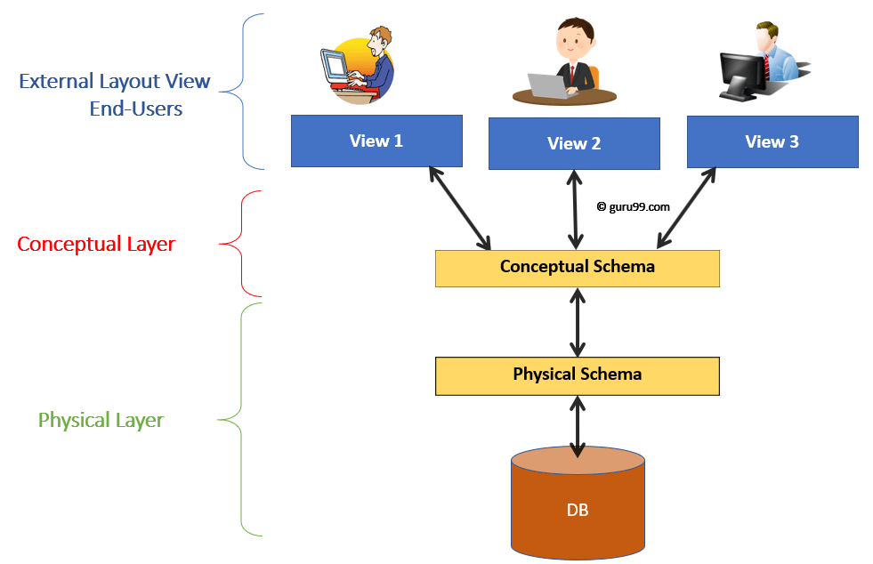
Levels of Abstraction
Three Schema Architecture for a Database System

Slide 37
Example: University Database
Physical schema:
Relations stored as unordered files.
Index on first column of Students.
Conceptual schema:
Students(sid: string, name: string, login: string, age: integer, gpa:real)
Courses(cid: string, cname:string, credits:integer)
Enrolled(sid:string, cid:string, grade:string)
External Schema (View):
View1- Course_info(cid:string,enrollment:integer)
View2-studeninfo(id:int. name:string)

Slide 38
Data Independence
Data Independence is defined as a property of DBMS that helps you to change the Database schema at one level of a database system without requiring to change the schema at the next higher level.
Data independence helps you to keep data separated from all programs that make use of it.
In DBMS there are two types of data independence
Physical data independence
Logical data independence.
One of the most important benefits of using a DBMS!

Slide 39
Physical Data Independence
Physical data independence can be defined as the capacity to change the internal schema without having to change the conceptual schema.
If we do any changes in the storage size of the database system server, then the Conceptual structure of the database will not be affected.
Physical data independence is used to separate conceptual levels from the internal levels.
Physical data independence occurs at the logical interface level.

Slide 40
Physical Data Independence (contd..)
Due to Physical independence, any of the below change will not affect the conceptual layer.
Using a new storage device like Hard Drive or Magnetic Tapes
Modifying the file organization technique in the Database
Switching to different data structures.
Changing the access method.
Modifying indexes.
Changes to compression techniques or hashing algorithms.
Change of Location of Database from say C drive to D Drive

Slide 41
Logical Data Independence
Logical data independence refers characteristic of being able to change the conceptual schema without having to change the external schema.
Logical data independence is used to separate the external level from the conceptual view.
If we do any changes in the conceptual view of the data, then the user view of the data would not be affected.
Logical data independence occurs at the user interface level.

Slide 42
Logical Data Independence (contd..)
Due to Logical independence, any of the below change will not affect the external layer.
Add/Modify/Delete a new attribute, entity or relationship is possible without a rewrite of existing application programs
Merging two records into one
Breaking an existing record into two or more records

Slide 43
Short Quiz
Which of the following is known as a set of entities of the same type that share same properties, or attributes? a) Relation set b) Tuples c) Entity set d) Entity Relation model
The values appearing in given attributes of any tuple in the referencing relation must likewise occur in specified attributes of at least one tuple in the referenced relation, according to _____________________ integrity constraint. a) Referential b) Primary c) Referencing d) Specific

Slide 44
Topic- Database Language Objective
DDL stands for Data Definition Language. DML stands for Data Manipulation Language. DDL statements are used to create database, schema, constraints, users, tables etc. DML statement is used to insert, update or delete the records.
DCL (Data Control Language) includes commands like GRANT and REVOKE, which are useful to give “rights & permissions.”
Transaction control language or TCL commands deal with the transaction within the database.
4. Data Query Language (DQL) is used to fetch the data from the database.

Slide 45
DATA BASE LANGUAGE (CO1)
A DBMS has appropriate languages and interfaces to express database queries and updates.
Database languages can be used to read, store and update the data in the database.
Two classes of languages
Procedural – user specifies what data is required and how to get those data
Declarative (nonprocedural) – user specifies what data is required without specifying how to get those data
SQL is the most widely used query language

Slide 46
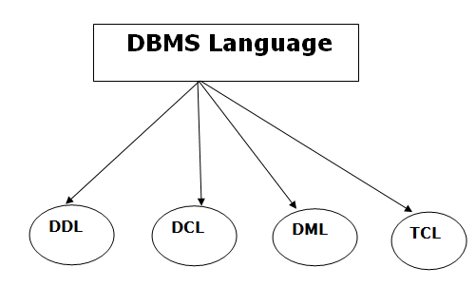
DATA BASE LANGUAGE

Slide 47
Data Definition Language (DDL)
DDL stands for Data Definition Language. It is used to define database structure or pattern.
It is used to create schema, tables, indexes, constraints, etc. in the database.
Using the DDL statements, you can create the skeleton of the database.
Data definition language is used to store the information of metadata like the number of tables and schemas, their names, indexes, columns in each table, constraints, etc.

Slide 48
Data Definition Language (DDL)
Here are some tasks that come under DDL:
Create: It is used to create objects in the database.
Alter: It is used to alter the structure of the database.
Drop: It is used to delete objects from the database.
Truncate: It is used to remove all records from a table.
Rename: It is used to rename an object.
Comment: It is used to comment on the data dictionary.
These commands are used to update the database schema that's why they come under Data definition language.

Slide 49
Data Manipulation Language (DML)
DML stands for Data Manipulation Language. It is used for accessing and manipulating data in a database. It handles user requests.
Here are some tasks that come under DML:
Select: It is used to retrieve data from a database.
Insert: It is used to insert data into a table.
Update: It is used to update existing data within a table.
Delete: It is used to delete all records from a table.
Merge: It performs UPSERT operation, i.e., insert or update operations.
Call: It is used to call a structured query language or a Java subprogram.
Explain Plan: It has the parameter of explaining data.
Lock Table: It controls concurrency.

Slide 50
Data Control Language (DCL)
DCL stands for Data Control Language. It is used to retrieve the stored or saved data.
The DCL execution is transactional. It also has rollback parameters.
(But in Oracle database, the execution of data control language does not have the feature of rolling back.)
Here are some tasks that come under DCL:
Grant: It is used to give user access privileges to a database.
Revoke: It is used to take back permissions from the user.
There are the following operations which have the authorization of Revoke:
CONNECT, INSERT, USAGE, EXECUTE, DELETE, UPDATE and SELECT.

Slide 51
Transaction Control Language (TCL)
TCL is used to run the changes made by the DML statement. TCL can be grouped into a logical transaction.
Here are some tasks that come under TCL:
Commit: It is used to save the transaction on the database.
Rollback: It is used to restore the database to original since the last Commit.

Slide 52
Short Quiz
The ability to query data, as well as insert, delete, and alter tuples, is offered by ____________ a) TCL (Transaction Control Language) b) DCL (Data Control Language) c) DDL (Data Definition Langauge) d) DML (Data Manipulation Langauge)
Which command is used to remove a relation from an SQL? a) Drop table b) Delete c) Purge d) Remove
17/02/22
52

Slide 53
Topic- Relational Model and SQL Objective
The purpose of the relational model is to provide a declarative method for specifying data and queries: users directly state what information the database contains and what information they want from it.
One of the major goals of Object relational data model is to close the gap between relational databases and the object oriented practises frequently used in many programming languages such as C++, C#, Java etc.
Be able to write SQL statements that edit existing data. Be able to write SQL statements that create database objects.
Understand the structure and design of relational databases. Understand the importance and major issues of database security and the maintenance of data integrity.
17/02/22
17/02/22
Dr Kumud Saxena ACSAI-0402 and DBMS Unit-1
53
53

Slide 54
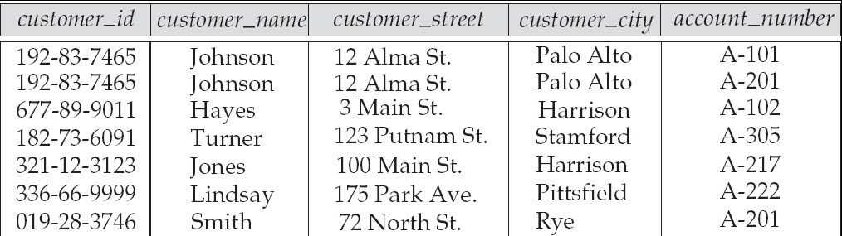
Relational Model
Example of tabular data in the relational model
Attributes

Slide 55
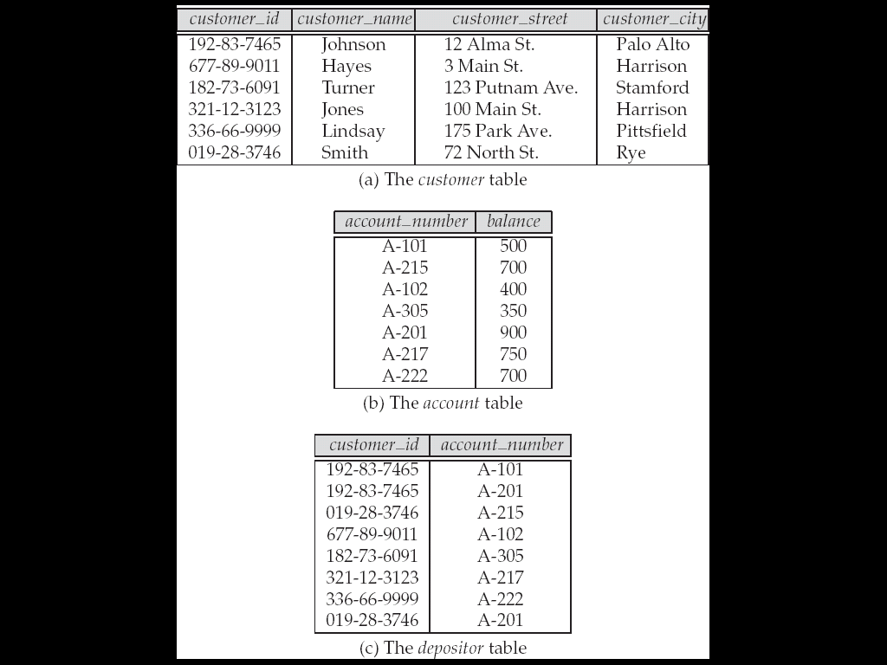
A Sample Relational Database

Slide 56
SQL
SQL: widely used non-procedural language
Example: Find the name of the customer with customer-id 192-83-7465 select customer.customer_name from customer where customer.customer_id = ‘192-83-7465’
Example: Find the balances of all accounts held by the customer with customer-id 192-83-7465 select account.balance from depositor, account where depositor.customer_id = ‘192-83-7465’ and depositor.account_number = account.account_number

Slide 57
SQL
Application programs generally access databases through one of
Language extensions to allow embedded SQL
Application program interface (e.g., ODBC/JDBC) which allow SQL queries to be sent to a database

Slide 58
Database Users
Users are differentiated by the way they expect to interact with
the system
Database Administrator-The DBA will then create a new account id and password for the user if he/she need to access the data base.
DBA is also responsible for providing security to the data base and he allows only the authorized users to access/modify the data base.
DBA also monitors the recovery and back up and provide technical support.
The DBA has a DBA account in the DBMS which called a system or superuser account.
DBA repairs damage caused due to hardware and/or software failures.

Slide 59
Database Users
Naïve users –are the unsophisticated who don’t have any DBMS knowledge but they frequently use the data base applications in their daily life to get the desired results.
For examples, Railway’s ticket booking users are naive users. Clerks in any bank is a naive user because they don’t have any DBMS knowledge but they still use the database and perform their given task.
System Analyst: System Analyst is a user who analyzes the requirements of parametric end users. They check whether all the requirements of end users are satisfied.
Sophisticated Users: Sophisticated users can be engineers, scientists, business analyst, who are familiar with the database. They can develop their own data base applications according to their requirement. They don’t write the program code but they interact the data base by writing SQL queries directly through the query processor.

Slide 60
Database Users
Data Base Designers : Data Base Designers are the users who design the structure of data base which includes tables, indexes, views, constraints, triggers, stored procedures. He/she controls what data must be stored and how the data items to be related.
Application Programmer: Application Program are the back end programmers who writes the code for the application programs. They are the computer professionals. These programs could be written in Programming languages such as Visual Basic, Developer, C, FORTRAN, COBOL etc.
Casual Users / Temporary Users : Casual Users are the users who occasionally use/access the data base but each time when they access the data base they require the new information, for example, Middle or higher level manager.

Slide 61
Data storage and Querying
The database system is divided into three components
Storage management
Query processing
Transaction processing

Slide 62
Storage Management
Storage manager is a program module that provides the interface between the low-level data stored in the database and the application programs and queries submitted to the system.
The storage manager is responsible to the following tasks:
Interaction with the file manager
Efficient storing, retrieving and updating of data
Issues:
Storage access
File organization
Indexing and hashing

Slide 63
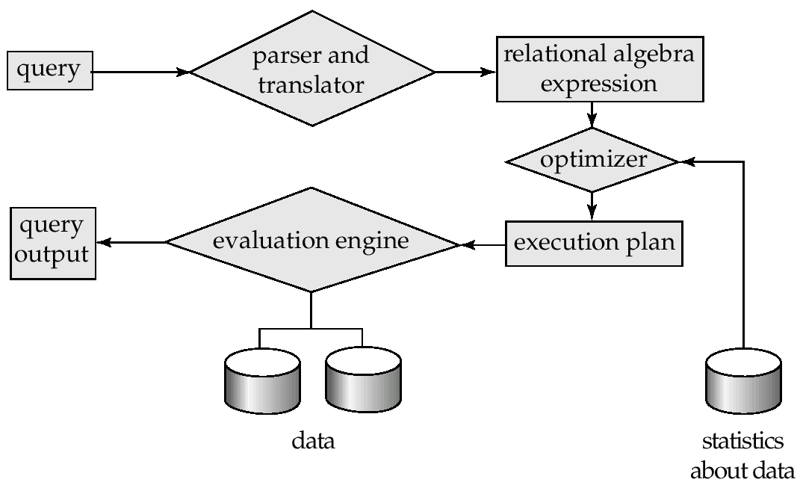
Query Processing
1. Parsing and translation
2. Optimization
3. Evaluation

Slide 64
Query Processing (Cont.)
Alternative ways of evaluating a given query
Equivalent expressions
Different algorithms for each operation
Cost difference between a good and a bad way of evaluating a query can be enormous
Need to estimate the cost of operations
Depends critically on statistical information about relations which the database must maintain
Need to estimate statistics for intermediate results to compute cost of complex expressions

Slide 65
Transaction Management
A transaction is a collection of operations that performs a single logical function in a database application
Transaction-management component ensures that the database remains in a consistent (correct) state despite system failures (e.g., power failures and operating system crashes) and transaction failures.
Concurrency-control manager controls the interaction among the concurrent transactions, to ensure the consistency of the database.

Slide 66
Database Architecture (CO1)
The architecture of a database systems is greatly influenced by the underlying computer system on which the database is running:
Centralized
Client-server
Parallel (multiple processors and disks)
Distributed

Slide 67
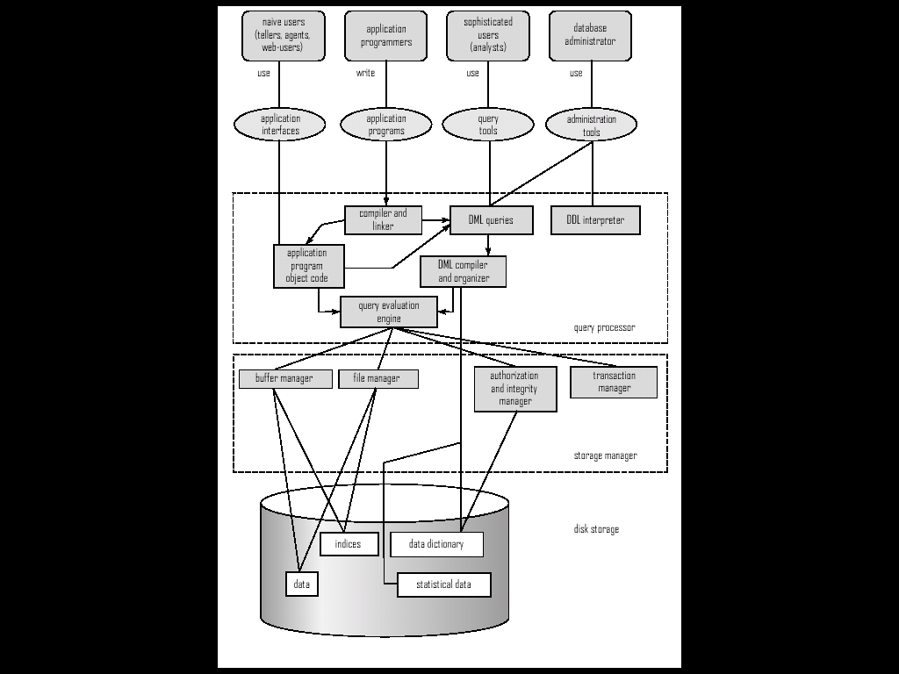
Overall System Structure

Slide 68
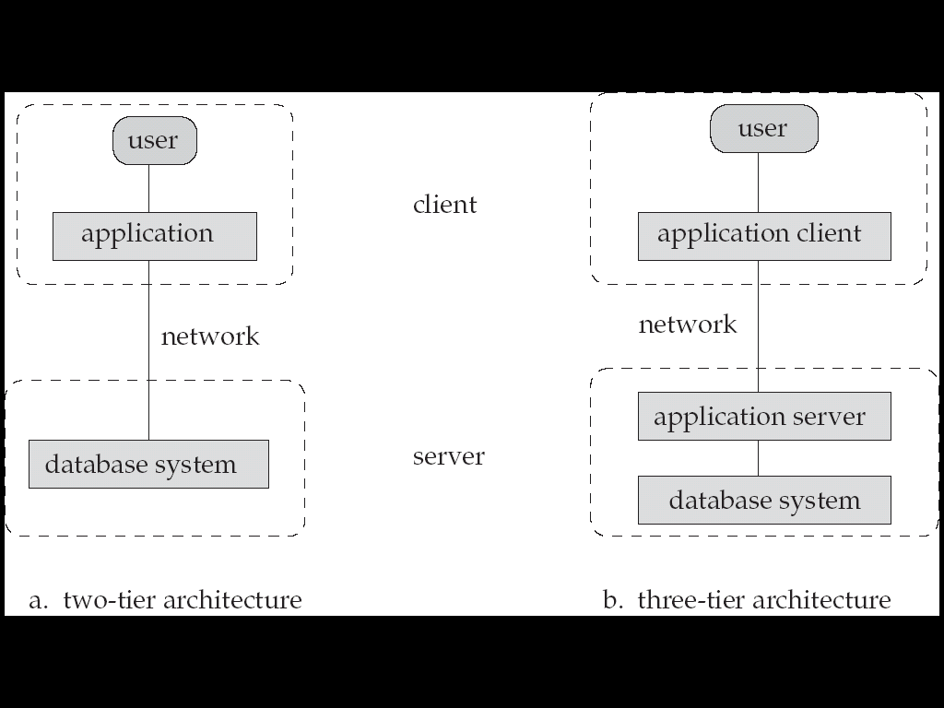
Database Application Architectures

Slide 69
Database Design (CO1)
Conceptual design: (ER Model is used at this stage.)
What are the entities and relationships in the enterprise?
What information about these entities and relationships should we store in the database?
What are the integrity constraints or business rules that hold?
A database `schema’ in the ER Model can be represented pictorially (ER diagrams).
Can map an ER diagram into a relational schema.

Slide 70
Short Quiz
After groups have been established, SQL applies predicates in the ___________ clause, allowing aggregate functions to be used. a) Where b) Having c) Group by d) With
Why the following statement is erroneous?
SELECT dept_name, ID, avg (salary) FROM instructor GROUP BY dept_name;
a) Dept_id should not be used in group by clause b) Group by clause is not valid in this query c) Avg(salary) should not be selected d) None

Slide 71
Topic- ER Model Objective
An entity relationship diagram gives a snapshot of how these entities relate to each other. You could call it the blueprint that underpins your business architecture, offering a visual representation of the relationships between different sets of data (entities).
An Entity Relationship (ER) Diagram is a type of flowchart that illustrates how “entities” such as people, objects or concepts relate to each other within a system.

Slide 72
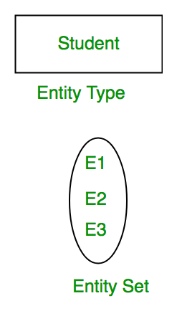
Introduction of ER Model
A database can be modeled as:
a collection of entities,
relationship among entities.
An entity is an object that exists and is distinguishable from other objects.
Example: specific person, company, event, plant
Entities have attributes
Example: people have names and addresses
An entity set is a set of entities of the same type that share the same properties.
Example: set of all persons, companies, trees, holidays

Slide 73
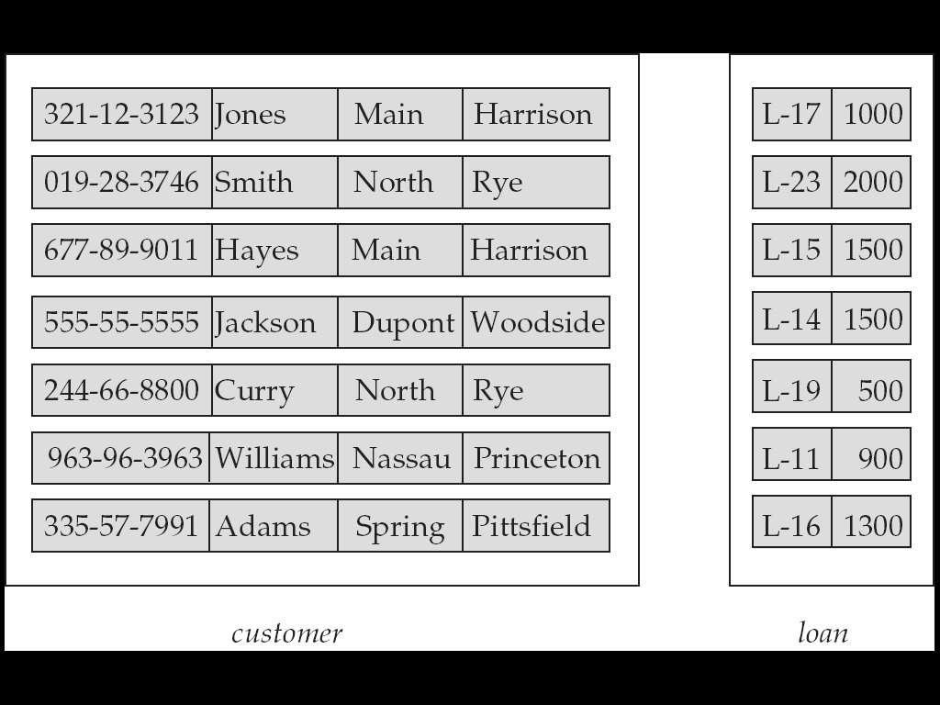
Entity Sets customer and loan
customer_id customer_ customer_ customer_ loan_ amount name street city number

Slide 74
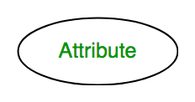
Attributes
An entity is represented by a set of attributes, that is descriptive properties possessed by all members of an entity set.
In ER diagram, attribute is represented by an oval.
Domain – the set of permitted values for each attribute
Example: customer = (customer_id, customer_name, customer_street, customer_city )
loan = (loan_number, amount )

Slide 75
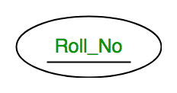
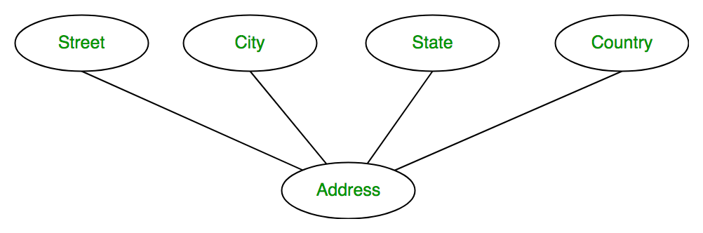
Attribute Type
Key Attribute – The attribute which uniquely identifies each entity in the entity set is called key attribute. For example, Roll_No will be unique for each student. In ER diagram, key attribute is represented by an oval with underlying lines.
Composite Attribute – An attribute composed of many other attribute is called as composite attribute. For example, Address attribute of student Entity type consists of Street, City, State, and Country. In ER diagram, composite attribute is represented by an oval comprising of ovals.

Slide 76
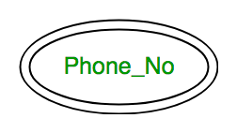
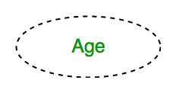
Attribute Type
Multivalued Attribute – An attribute consisting more than one value for a given entity. For example, Phone_No (can be more than one for a given student). In ER diagram, multivalued attribute is represented by double oval.
Derived Attribute – An attribute which can be derived from other attributes of the entity type is known as derived attribute. e.g.; Age (can be derived from DOB). In ER diagram, derived attribute is represented by dashed oval.

Slide 77
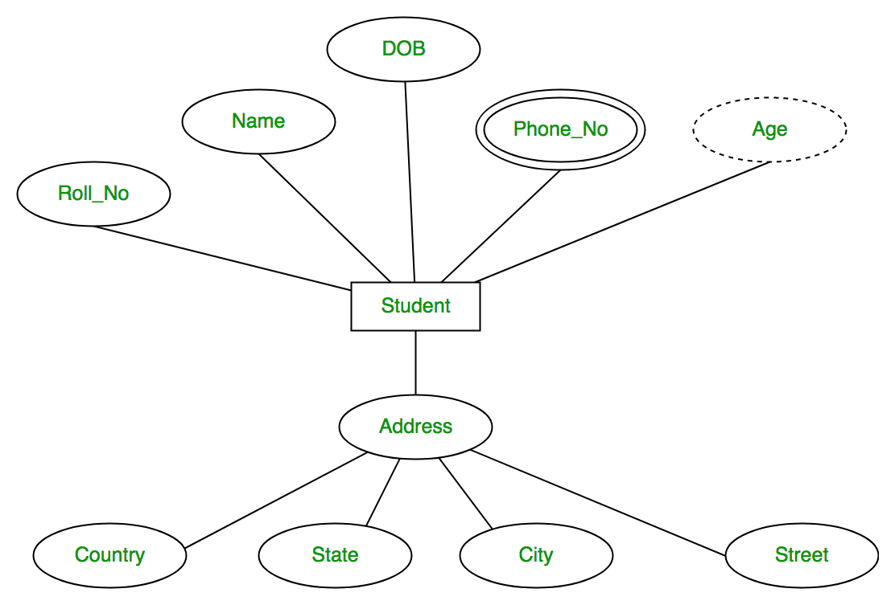
Attribute Type
The complete entity type Student with its attributes can be represented as:

Slide 78
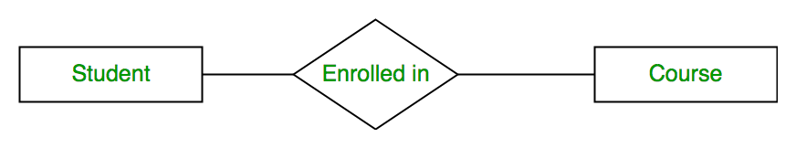
Relationship Type
A relationship type represents the association between entity types.
For example, ‘Enrolled in’ is a relationship type that exists between entity type Student and Course.
In ER diagram, relationship type is represented by a diamond and connecting the entities with lines.

Slide 79
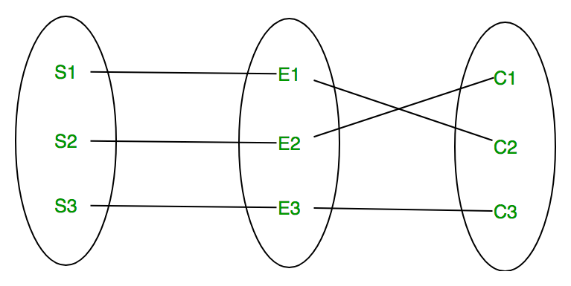
Relationship Set
A set of relationships of same type is known as relationship set.
The following relationship set depicts S1 is enrolled in C2, S2 is enrolled in C1 and S3 is enrolled in C3.

Slide 80
Degree of Relationship Set
The number of different entity sets participating in a relationship set is called as degree of a relationship set.
Unary Relationship
Binary Relationship
n-ary Relationship

Slide 81
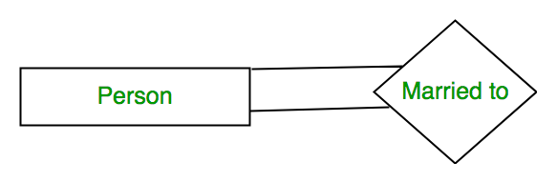
Unary Relationship
When there is only ONE entity set participating in a relation, the relationship is called as unary relationship.
For example, one person is married to only one person.

Slide 82
Binary Relationship
When there are TWO entities set participating in a relation, the relationship is called as binary relationship.
For example, Student is enrolled in Course.

Slide 83
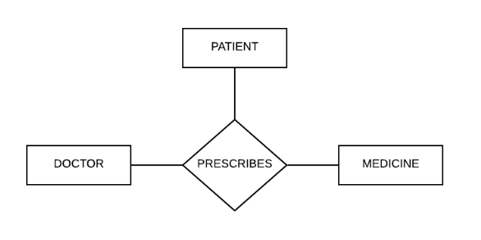
n-ary Relationship
When there are n entities set participating in a relation, the relationship is called as n-ary relationship.

Slide 84
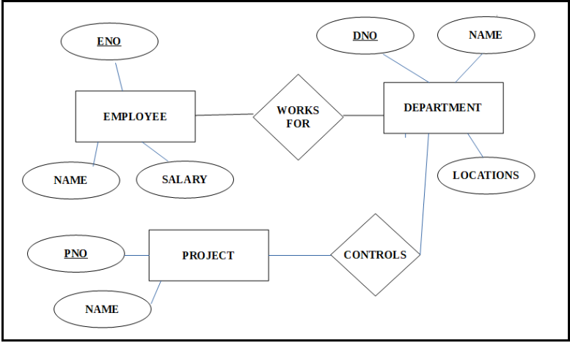
Example ER Diagram

Slide 85
Mapping Cardinality
The number of times an entity of an entity set participates in a relationship set is known as cardinality.
Cardinality can be of different types:
One to one
One to many
Many to one
Many to many

Slide 86
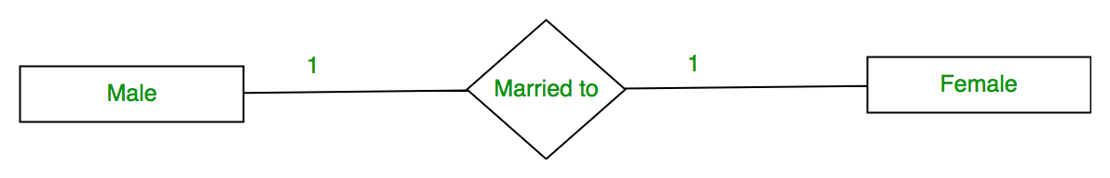
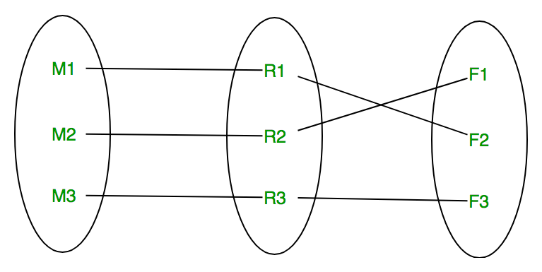
One to one
When each entity in each entity set can take part only once in the relationship, the cardinality is one to one. Let us assume that a male can marry to one female and a female can marry to one male. So the relationship will be one to one.
Using Sets, it can be represented as:

Slide 87
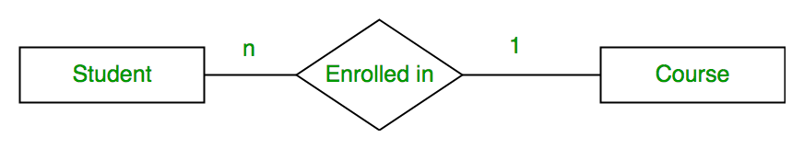
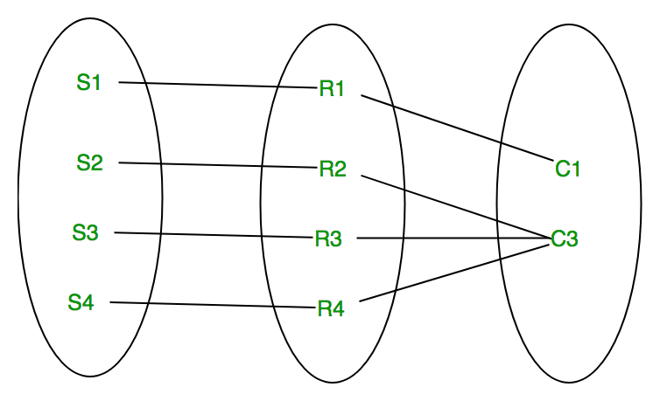
Many to one
When entities in one entity set can take part only once in the relationship set and entities in other entity set can take part more than once in the relationship set, cardinality is many to one
Using Sets, it can be represented as:

Slide 88
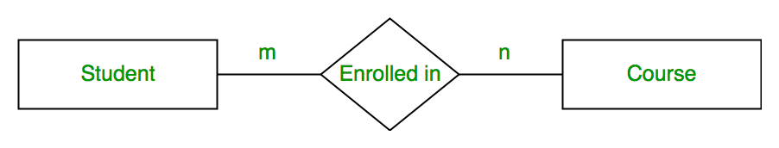
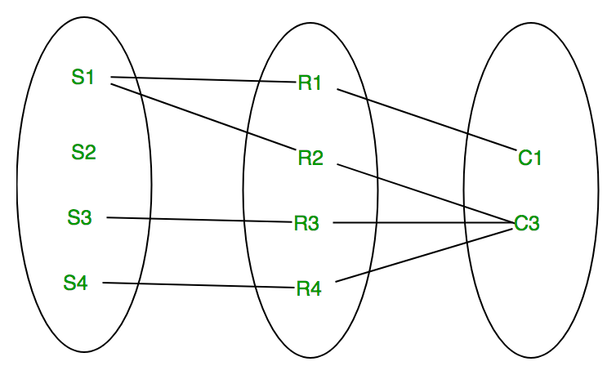
Many to many
When entities in all entity sets can take part more than once in the relationship cardinality is many to many. Let us assume that a student can take more than one course and one course can be taken by many students. So the relationship will be many to many.
Using sets, it can be represented as:

Slide 89
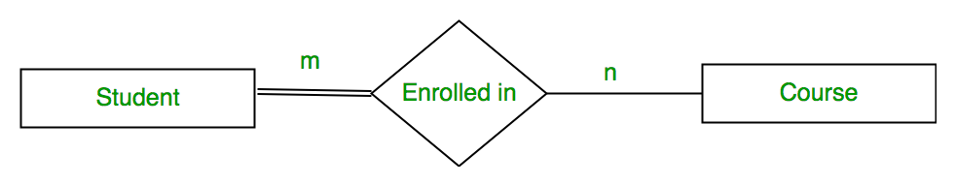
Participation Constraint
Total Participation – Each entity in the entity set must participate in the relationship. If each student must enroll in a course, the participation of student will be total. Total participation is shown by double line in ER diagram.
Partial Participation – The entity in the entity set may or may NOT participate in the relationship. If some courses are not enrolled by any of the student, the participation of course will be partial.

Slide 90
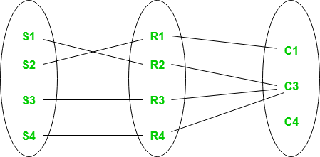
Participation Constraint (contd..)
Using set, it can be represented as
Every student in Student Entity set is participating in relationship but there exists a course C4 which is not taking part in the relationship.

Slide 91
Weak Entity Type & Identifying Relationship
An entity type has a key attribute which uniquely identifies each entity in the entity set.
But there exists some entity type for which key attribute can’t be defined. These are called Weak Entity type.
For example, A company may store the information of dependents (Parents, Children, Spouse) of an Employee.
But the dependents don’t have existence without the employee.
So Dependent will be weak entity type and Employee will be Identifying Entity type for Dependent.

Slide 92
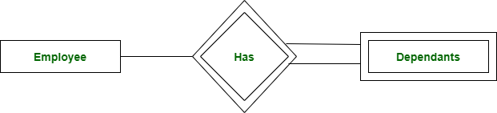
Weak Entity Type & Identifying Relationship
A weak entity type is represented by a double rectangle. The participation of weak entity type is always total. The relationship between weak entity type and its identifying strong entity type is called identifying relationship and it is represented by double diamond.

Slide 93
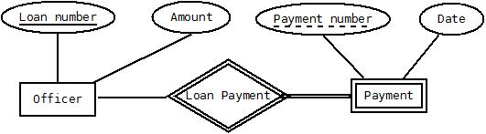

Slide 94
Keys in DBMS
KEYS in DBMS is an attribute or set of attributes which helps you to identify a row(tuple) in a relation(table).
They allow you to find the relation between two tables.
Keys help you uniquely identify a row in a table by a combination of one or more columns in that table.
Example:-
In the above-given example, employee ID is a primary key because it uniquely identifies an employee record. In this table, no other employee can have the same employee ID.
Employee ID | FirstName | LastName
11 | Andrew | Johnson
22 | Tom | Wood
33 | Alex | Hale

Slide 95
Why we need a Key?
Here are some reasons for using SQL key in the DBMS system.
Keys help you to identify any row of data in a table.
In a real-world application, a table could contain thousands of records. Moreover, the records could be duplicated.
Keys in RDBMS ensure that you can uniquely identify a table record despite these challenges.
Allows you to establish a relationship between and identify the relation between tables
Help you to enforce identity and integrity in the relationship.

Slide 96
Types of Keys in DBMS
There are mainly Eight different types of Keys in DBMS and each key has it’s different functionality:
Super Key – A super key is a group of single or multiple keys which identifies rows in a table.
Primary Key – is a column or group of columns in a table that uniquely identify every row in that table.
Candidate Key – is a set of attributes that uniquely identify tuples in a table. Candidate Key is a super key with no repeated attributes.
Alternate Key – is a column or group of columns in a table that uniquely identify every row in that table.

Slide 97
Types of Keys in DBMS (contd..)
Foreign Key – is a column that creates a relationship between two tables. The purpose of Foreign keys is to maintain data integrity and allow navigation between two different instances of an entity.
Compound Key – has two or more attributes that allow you to uniquely recognize a specific record. It is possible that each column may not be unique by itself within the database.
Composite Key – is a combination of two or more columns that uniquely identify rows in a table. The combination of columns guarantees uniqueness, though individual uniqueness is not guaranteed.
Surrogate Key – An artificial key which aims to uniquely identify each record is called a surrogate key. These kind of key are unique because they are created when you don’t have any natural primary key.

Slide 98
Super key
A superkey is a group of single or multiple keys which identifies rows in a table. A Super key may have additional attributes that are not needed for unique identification.
Example:
In the above-given example, EmpSSN and EmpNum name are superkeys.
EmpSSN | EmpNum | Empname
9812345098 | AB05 | Shown
9876512345 | AB06 | Roslyn
199937890 | AB07 | James

Slide 99
Primary Key
PRIMARY KEY in DBMS is a column or group of columns in a table that uniquely identify every row in that table. The Primary Key can’t be a duplicate meaning the same value can’t appear more than once in the table. A table cannot have more than one primary key.
Example:
In the following example, StudID is a Primary Key.
StudID | Roll No | First Name | LastName | Email
1 | 11 | Tom | Price | abc@gmail.com
2 | 12 | Nick | Wright | xyz@gmail.com
3 | 13 | Dana | Natan | mno@yahoo.com

Slide 100
Primary Key (contd..)
Rules for defining Primary key:
Two rows can’t have the same primary key value
It must for every row to have a primary key value.
The primary key field cannot be null.
The value in a primary key column can never be modified or updated if any foreign key refers to that primary key.

Slide 101
Alternate key
ALTERNATE KEYS is a column or group of columns in a table that uniquely identify every row in that table. A table can have multiple choices for a primary key but only one can be set as the primary key. All the keys which are not primary key are called an Alternate Key.
Example:
In this table, StudID, Roll No, Email are qualified to become a primary key. But since StudID is the primary key, Roll No, Email becomes the alternative key.
StudID | Roll No | First Name | LastName | Email
1 | 11 | Tom | Price | abc@gmail.com
2 | 12 | Nick | Wright | xyz@gmail.com
3 | 13 | Dana | Natan | mno@yahoo.com

Slide 102
Candidate Key
CANDIDATE KEY in SQL is a set of attributes that uniquely identify tuples in a table. Candidate Key is a super key with no repeated attributes. The Primary key should be selected from the candidate keys. Every table must have at least a single candidate key. A table can have multiple candidate keys but only a single primary key.
Example:
Candidate key Example: In the given table Stud ID, Roll No, and email are candidate keys which help us to uniquely identify the student record in the table.
StudID | Roll No | First Name | LastName | Email
1 | 11 | Tom | Price | abc@gmail.com
2 | 12 | Nick | Wright | xyz@gmail.com
3 | 13 | Dana | Natan | mno@yahoo.com

Slide 103
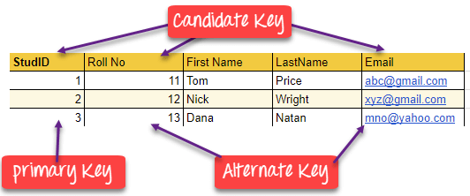
Candidate Key (contd..)
Properties of Candidate key:
It must contain unique values
Candidate key in SQL may have multiple attributes
Must not contain null values
It should contain minimum fields to ensure uniqueness
Uniquely identify each record in a table

Slide 104
Foreign key
FOREIGN KEY is a column that creates a relationship between two tables. The purpose of Foreign keys is to maintain data integrity and allow navigation between two different instances of an entity. It acts as a cross-reference between two tables as it references the primary key of another table.
Example:
DeptCode | DeptName
001 | Science
002 | English
005 | Computer
Teacher ID | Fname | Lname
B002 | David | Warner
B017 | Sara | Joseph
B009 | Mike | Brunton

Slide 105
Foreign key (contd..)
In this example, we have two tables, teacher and department in a school. However, there is no way to see which teacher work in which department.
In this table, adding the foreign key Deptcode to the Teacher, we can create a relationship between the two tables.
This concept is also known as Referential Integrity.
Teacher ID | DeptCode | Fname | Lname
B002 | 002 | David | Warner
B017 | 002 | Sara | Joseph
B009 | 001 | Mike | Brunton

Slide 106
Compound key
COMPOUND KEY has two or more attributes that allow you to uniquely recognize a specific record. It is possible that each column may not be unique by itself within the database. However, when combined with the other column or columns the combination of composite keys become unique.
Example:
In this example, OrderNo and ProductID can’t be a primary key as it does not uniquely identify a record. However, a compound key of Order ID and Product ID could be used as it uniquely identified each record.
OrderNo | PorductID | Product Name | Quantity
B005 | JAP102459 | Mouse | 5
B005 | DKT321573 | USB | 10
B005 | OMG446789 | LCD Monitor | 20
B004 | DKT321573 | USB | 15
B002 | OMG446789 | Laser Printer | 3

Slide 107
Composite key
COMPOSITE KEY is a combination of two or more columns that uniquely identify rows in a table. The combination of columns guarantees uniqueness, though individually uniqueness is not guaranteed. Hence, they are combined to uniquely identify records in a table.
The difference between compound and the composite key is that any part of the compound key can be a foreign key, but the composite key may or maybe not a part of the foreign key.

Slide 108
Surrogate key
SURROGATE KEYS is An artificial key which aims to uniquely identify each record is called a surrogate key.
This kind of partial key in dbms is unique because it is created when you don’t have any natural primary key.
They do not lend any meaning to the data in the table. Surrogate key in DBMS is usually an integer.
A surrogate key is a value generated right before the record is inserted into a table.
Surrogate keys in sql are allowed when
No property has the parameter of the primary key.
In the table when the primary key is too big or complicated.

Slide 109
Surrogate key (contd..)
Example:
Above, given example, shown shift timings of the different employee. In this example, a surrogate key is needed to uniquely identify each employee.
Fname | Lastname | Start Time | End Time
Anne | Smith | 09:00 | 18:00
Jack | Francis | 08:00 | 17:00
Anna | McLean | 11:00 | 20:00
Shown | Willam | 14:00 | 23:00

Slide 110
Difference b/w Primary key & Foreign key
Primary Key | Foreign Key
Helps you to uniquely identify a record in the table. | It is a field in the table that is the primary key of another table.
Primary Key never accept null values. | A foreign key may accept multiple null values.
Primary key is a clustered index and data in the DBMS table are physically organized in the sequence of the clustered index. | A foreign key cannot automatically create an index, clustered or non-clustered. However, you can manually create an index on the foreign key.
You can have the single Primary key in a table. | You can have multiple foreign keys in a table.

Slide 111
Short Quiz
Q. Given the basic ER and relational models, which of the following is INCORRECT?
answer choices
An attribute of an entity can have more than one value.
An attribute of an entity can be composite.
In a row of a relational table, an attribute can have more than one value.
In a row of a relational table, an attribute can have exactly one value or a NULL value.
Q. Which type of entity cannot exist in the database unless another type of entity also exists in the database, but does not require that the identifier of that other entity be included as part of its own identifier?
Weak entity
Strong entity
ID-dependent entity
ID- independent entity

Slide 112
Topic- Generalization, Specialization and Aggregation Objective
Generalization of Entities helps in establishing relationships between the tables, as they have common attributes to be identified. It makes the structuring of the database management simpler and easy to identify all the relevant attributes.
Specialization helps in defining the set of subclasses of the entity type. Also, it helps in establishing extra specific attributes with all subclasses and added specific relationship types between each subclass and the other entity types or the other subclasses.
Inheritance is an important feature of Generalization and Specialization. It allows lower-level entities to inherit the attributes of higher-level entities. For example, the attributes of a Person class such as name, age, and gender can be inherited by lower-level entities such as Student or Teacher.

Slide 113
Generalization
Generalization is the process of extracting common properties from a set of entities and create a generalized entity from it.
It is a bottom-up approach in which two or more entities can be generalized to a higher level entity if they have some attributes in common.
For Example, STUDENT and FACULTY can be generalized to a higher level entity called PERSON as shown in Figure.
In this case, common attributes like P_NAME, P_ADD become part of higher entity (PERSON) and specialized attributes like S_FEE become part of specialized entity (STUDENT).

Slide 114
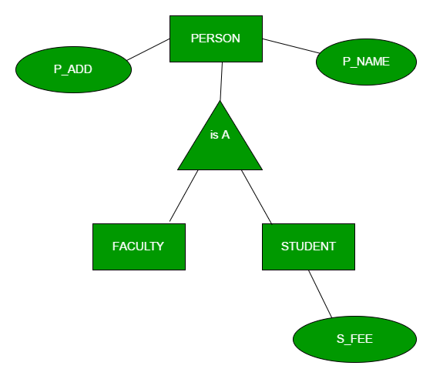
Example:

Slide 115
Specialization
In specialization, an entity is divided into sub-entities based on their characteristics.
It is a top-down approach where higher level entity is specialized into two or more lower level entities.
For Example, EMPLOYEE entity in an Employee management system can be specialized into DEVELOPER, TESTER etc. as shown in Figure.
In this case, common attributes like E_NAME, E_SAL etc. become part of higher entity (EMPLOYEE) and specialized attributes like TES_TYPE become part of specialized entity (TESTER).

Slide 116
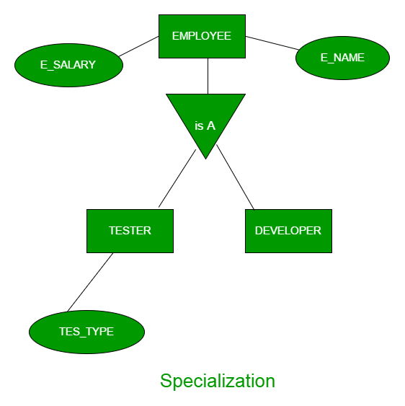
Example:

Slide 117
Aggregation
An ER diagram is not capable of representing relationship between an entity and a relationship which may be required in some scenarios.
In those cases, a relationship with its corresponding entities is aggregated into a higher level entity.
Aggregation is an abstraction through which we can represent relationships as higher level entity sets.
For Example, Employee working for a project may require some machinery. So, REQUIRE relationship is needed between relationship WORKS_FOR and entity MACHINERY. Using aggregation, WORKS_FOR relationship with its entities EMPLOYEE and PROJECT is aggregated into single entity and relationship REQUIRE is created between aggregated entity and MACHINERY.

Slide 118
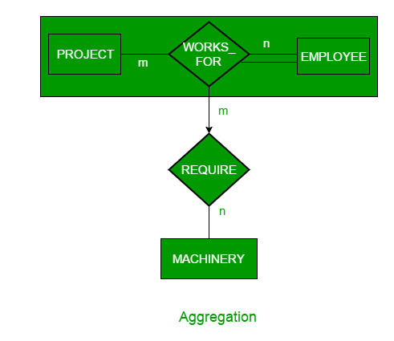
Example:

Slide 119
Topic –
Reduction of an ER diagrams to tables Objectives
Mapping an Entity Relationship (ER) model gives a good overview of the design of a system with the goal of making the system easier to understand at a technical level.
The ER diagrams can be mapped to a relation schema, which means we can clearly display the relationship between its members.
An Entity Relationship (ER) Diagram is a type of flowchart that illustrates how “entities” such as people, objects or concepts relate to each other within a system.

Slide 120
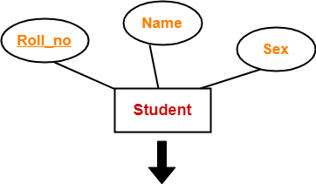
Reduction of an ER diagrams to tables
Rule-01: For Strong Entity Set With Only Simple Attributes
A strong entity set with only simple attributes will require only one table in relational model.
Attributes of the table will be the attributes of the entity set.
The primary key of the table will be the key attribute of the entity set.
Schema : Student ( Roll_no , Name , Sex )

Slide 121
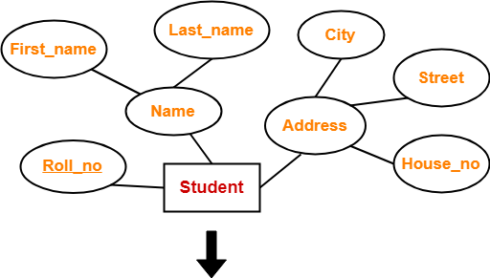
RULE-02
Rule-02: For Strong Entity Set With Composite Attributes
A strong entity set with any number of composite attributes will require only one table in relational model.
While conversion, simple attributes of the composite attributes are taken into account and not the composite attribute itself.
Schema : Student ( Roll_no , First_name , Last_name , House_no , Street , City )

Slide 122
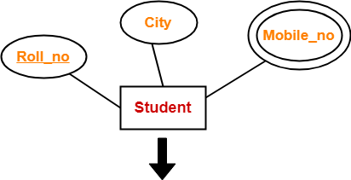
RULE-03
Rule-03: For Strong Entity Set With Multi Valued Attributes
A strong entity set with any number of multi valued attributes will require two tables in relational model.
One table will contain all the simple attributes with the primary key.
Other table will contain the primary key and all the multi valued attributes.
Roll_no | City
Roll_no | Mobile_no

Slide 123
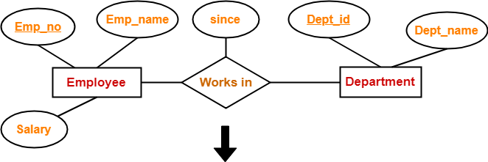
RULE-04
Rule-04: Translating Relationship Set into a Table
A relationship set will require one table in the relational model.
Attributes of the table are-
Primary key attributes of the participating entity sets
Its own descriptive attributes if any.
Set of non-descriptive attributes will be the primary key.
Schema : Works in ( Emp_no , Dept_id , since )

Slide 124
RULE-05
Rule-05: For Binary Relationships With Cardinality Ratios
The following four cases are possible-
Case-01: Binary relationship with cardinality ratio m:n
Case-02: Binary relationship with cardinality ratio 1:n
Case-03: Binary relationship with cardinality ratio m:1
Case-04: Binary relationship with cardinality ratio 1:1

Slide 125
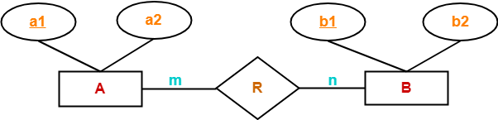
RULE-05 (contd..)
Case-01: For Binary Relationship With Cardinality Ratio m:n
Here, three tables will be required-
A ( a1 , a2 )
R ( a1 , b1 )
B ( b1 , b2 )

Slide 126
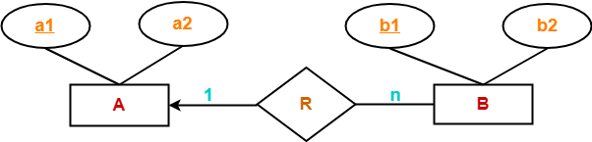
RULE-05 (contd..)
Case-02: For Binary Relationship With Cardinality Ratio 1:n
Here, two tables will be required-
A ( a1 , a2 )
BR ( a1 , b1 , b2 )
NOTE- Here, combined table will be drawn for the entity set B and relationship set R.

Slide 127
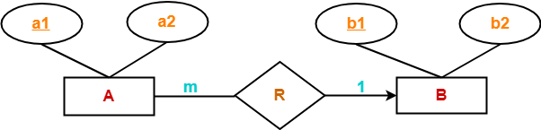
RULE-05 (contd..)
Case-03: For Binary Relationship With Cardinality Ratio m:1
Here, two tables will be required-
AR ( a1 , a2 , b1 )
B ( b1 , b2 )
NOTE- Here, combined table will be drawn for the entity set A and relationship set R.

Slide 128
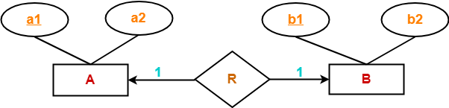
RULE-05 (contd..)
Case-04: For Binary Relationship With Cardinality Ratio 1:1
Here, two tables will be required. Either combine ‘R’ with ‘A’ or ‘B’
Way-01:
AR ( a1 , a2 , b1 )
B ( b1 , b2 )
Way-02:
A ( a1 , a2 )
BR ( a1 , b1 , b2 )

Slide 129
RULE-06
Rule-06: For Binary Relationship With Both Cardinality Constraints and Participation Constraints-
Case-01: For Binary Relationship With Cardinality Constraint and Total Participation Constraint From One Side
Case-02: For Binary Relationship With Cardinality Constraint and Total Participation Constraint From Both Sides-

Slide 130
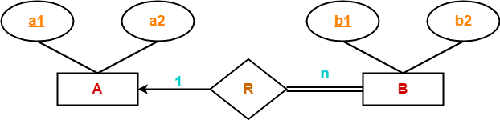
RULE-06 (contd..)
Case-01: For Binary Relationship With Cardinality Constraint and Total Participation Constraint From One Side
Because cardinality ratio = 1 : n , so we will combine the entity set B and relationship set R.
Then, two tables will be required-
A ( a1 , a2 )
BR ( a1 , b1 , b2 )
Because of total participation, foreign key a1 has acquired NOT NULL constraint, so it can’t be null now.

Slide 131
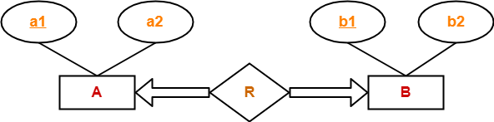
RULE-06 (contd..)
Case-02: For Binary Relationship With Cardinality Constraint and Total Participation Constraint From Both Sides
If there is a key constraint from both the sides of an entity set with total participation, then that binary relationship is represented using only single table.
Here, Only one table is required.
ARB ( a1 , a2 , b1 , b2 )

Slide 132

RULE-07
Rule-07: For Binary Relationship With Weak Entity Set
Weak entity set always appears in association with identifying relationship with total participation constraint.
Here, two tables will be required-
A ( a1 , a2 )
BR ( a1 , b1 , b2 )

Slide 133
Examples of ER Diagram

Slide 134

ER Diagram For Department

Slide 135

ER Diagram for Company

Slide 136
Summary of Conceptual Design
Conceptual design follows requirements analysis,
Yields a high-level description of data to be stored
ER model popular for conceptual design
Constructs are expressive, close to the way people think about their applications.
Basic constructs: entities, relationships, and attributes (of entities and relationships).
Some additional constructs: weak entities, ISA hierarchies, and aggregation.
Note: There are many variations on ER model.

Slide 137
Summary of ER (Contd.)
ER design is subjective. There are often many ways to model a given scenario! Analyzing alternatives can be tricky, especially for a large enterprise. Common choices include:
Entity vs. attribute, entity vs. relationship, binary or n-ary relationship, whether or not to use ISA hierarchies, and whether or not to use aggregation.
Ensuring good database design: resulting relational schema should be analyzed and refined further. FD information and normalization techniques are especially useful.

Slide 138
Daily Quiz
Define Database System.
What do you understand by data independence?
Explain types of attributes in ER diagram.
What is generalization.
What do you understand by primary key?
Explain participation cardinality.

Slide 139
Weekly Assignment
Define: Data, Database, and Database System.
What is data independence? What are differences between Logical Data Independence and Physical Data Independence?
Give example of Simple, Composite, Single –valued and Multi-valued attributes of an entity.
What is the difference between Generalization & Specialization with respect to Database?
What is difference between total and partial participation? Explain by suitable example.
Construct an E-R diagram for a hospital with a set of patients and a set of medical doctors. Associated with each patient, a log of the various tests and examinations conducted.

Slide 140
Topic Links
https://www.geeksforgeeks.org/last-minute-notes-dbms/
https://www.geeksforgeeks.org/quiz-corner-gq/#DBMS%20Mock%20Tests
https://www.geeksforgeeks.org/commonly-asked-dbms-interview-questions/
https://www.geeksforgeeks.org/commonly-asked-dbms-interview-questions-set-2/

Slide 141
MCQ s
The entity relationship set is represented in E-R diagram as a) Double diamonds b) Undivided rectangles c) Dashed lines d) Diamond
The Rectangles divided into two parts represents a) Entity set b) Relationship set c) Attributes of a relationship set d) Primary key

Slide 142
MCQ s
An entity set that does not have sufficient attributes to form a primary key is termed a __________ a) Strong entity set b) Variant set c) Weak entity set d) Variable set
What term is used to refer to a specific record in your music database; for instance; information stored about a specific album? a) Relation b) Instance c) Table d) Column

Slide 143
Glossary Questions
What are the features of Database language?
What do database languages do?
Define database model.
What is SQL?
Enlist the various relationships of database.
Define DDL and DML.
Enlist some commands of DDL.

Slide 144
Old Question Papers
http://www.aktuonline.com/papers/btech-cs-5-sem-data-base-management-system-KCS501-2020.pdf
http://www.aktuonline.com/papers/btech-cs-5-sem-database-management-system-KCS-501-2018-19.pdf
http://www.aktuonline.com/papers/btech-cs-5-sem-database-management-system-ncs-502-2017-18.pdf
http://www.aktuonline.com/papers/btech-cs-5-sem-database-management-system-ncs-502-2016-17.pdf

Slide 145
Expected Questions for University Exam
Explain types of attributes in ER diagram.
Explain the difference between a weak and a strong entity set with example.
Discuss three level of abstractions or schemas architecture of DBMS.
Define constraint and its types in DBMS.
Compare Generalization, Specialization and aggregation with suitable examples.
Draw overall structure of DBMS and explain its components in brief.
Construct an E-R diagram for a hospital with a set of patients and a set of medical doctors. Associated with each patient, a log of the various tests and examinations conducted.

Slide 146
Recap of Unit
Knowledge of database architecture.
Knowledge of Entity Relationship model and its concepts.
Databse V/S File system.

Slide 147
Thank You

